Slide 1
Top Down Parsing (Recursive Descent) Computing First function

Slide 2
Top Down Parsing
Find a left-most derivation
Find (build) a parse tree
Start building from the root and work down…
As we search for a derivation
Must make choices:
Which rule to use
Where to use it
May run into problems!!

Slide 3
Top-Down Parsing
Recursive-Descent Parsing
Backtracking is needed (If a choice of a production rule does not work, we backtrack to try other alternatives.)
It is a general parsing technique, but not widely used.
Not efficient
Predictive Parsing
no backtracking
efficient
needs a special form of grammars (LL(1) grammars).

Slide 4
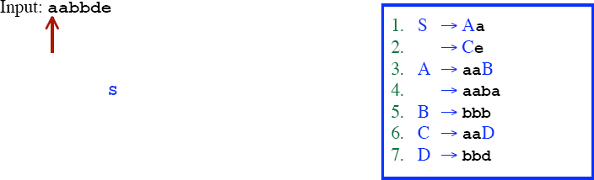
Recursive Descent Parsing (Backtracking)

Slide 5
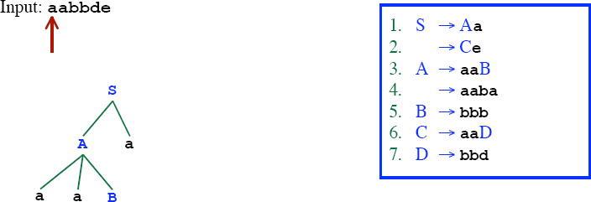
Recursive Descent Parsing (Backtracking)

Slide 6
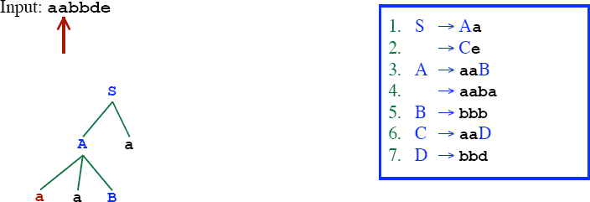
Recursive Descent Parsing (Backtracking)

Slide 7
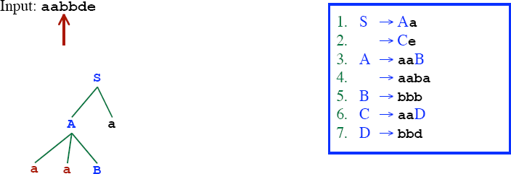
Recursive Descent Parsing (Backtracking)

Slide 8
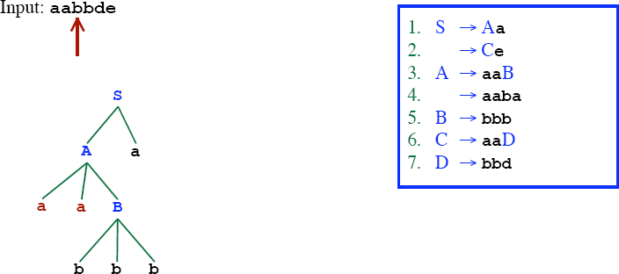
Recursive Descent Parsing (Backtracking)

Slide 9
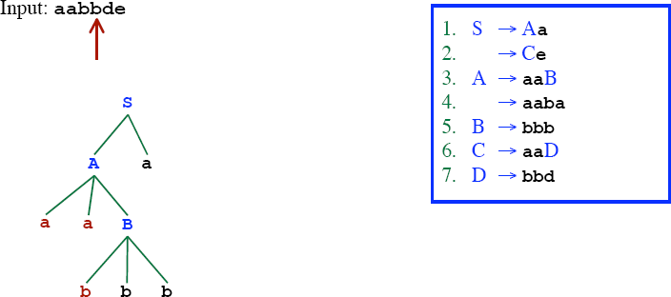
Recursive Descent Parsing (Backtracking)

Slide 10
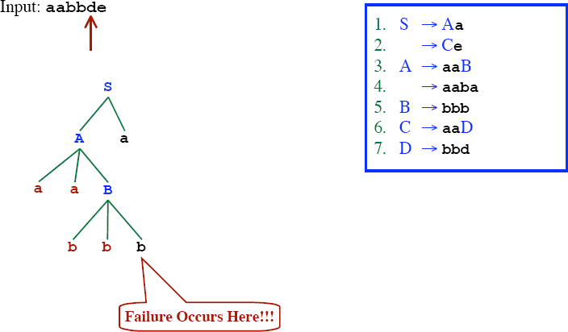
Recursive Descent Parsing (Backtracking)

Slide 11
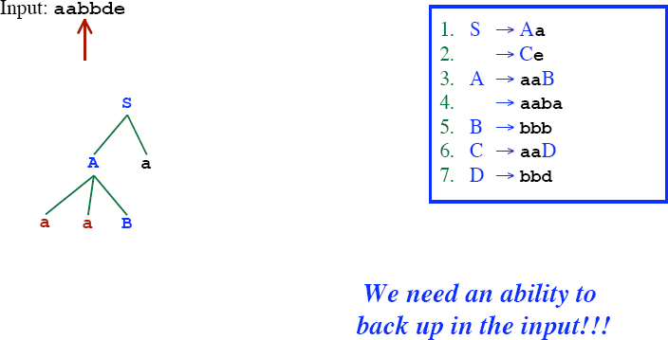
Recursive Descent Parsing (Backtracking)

Slide 12
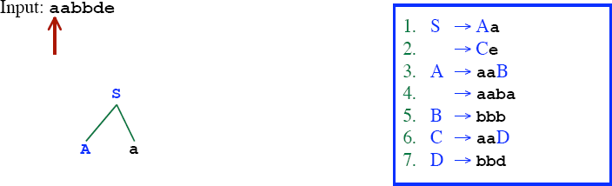
Recursive Descent Parsing (Backtracking)

Slide 13
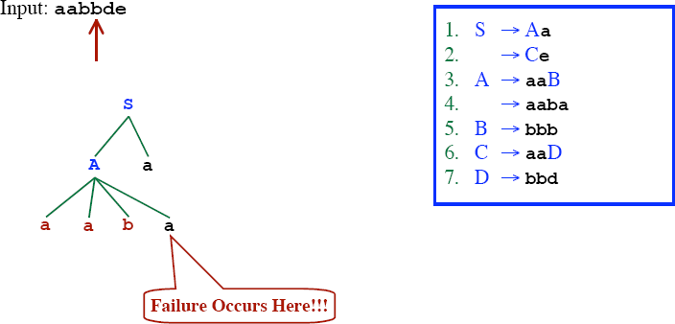
Recursive Descent Parsing (Backtracking)

Slide 14
Recursive Descent Parsing (Backtracking)

Slide 15

Recursive Descent Parsing (Backtracking)

Slide 16

Recursive Descent Parsing (Backtracking)

Slide 17

Recursive Descent Parsing (Backtracking)

Slide 18
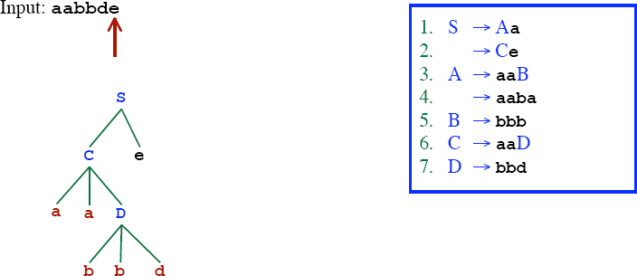
Recursive Descent Parsing (Backtracking)

Slide 19
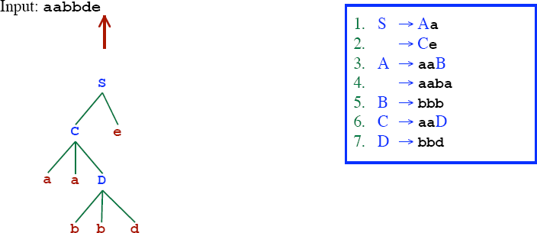
Recursive Descent Parsing (Backtracking)
Successfully parsed!!

Slide 20
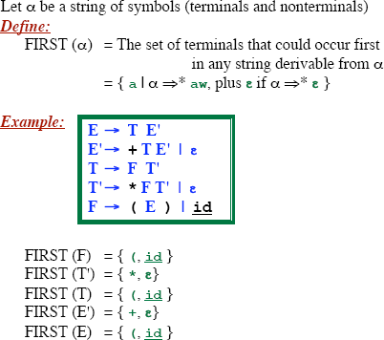
First Function

Slide 21
FIRST FUNCTION
S -> aB
B -> d
FIRST (α) = FIRST (aB) ={a}

Slide 22
FIRST FUNCTION
S -> AB
A -> c
B -> d
FIRST (α) = FIRST (AB) =?
FIRST (A) ={c}
SO, FIRST (α) = FIRST (AB) =FIRST (A) ={c}

Slide 23
FIRST FUNCTION
S -> AB
A -> c | ε
B -> d
FIRST (α) = FIRST (AB) =?
FIRST (A) ={c, ε}
FIRST (B) = {d}
SO, FIRST (α) = FIRST (AB) ={c,d}

Slide 24
FIRST FUNCTION
S -> AB
A -> c | ε
B -> d | ε
FIRST (α) = FIRST (AB) =?
FIRST (A) ={c, ε}
FIRST (B) = {d , ε }
SO, FIRST (α) = FIRST (AB) ={c,d, ε}

Slide 25
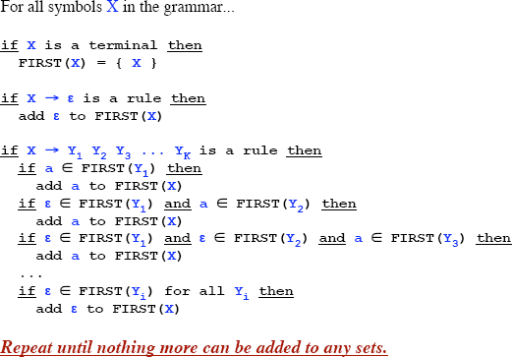
Computing the First Function

Slide 26
First - Example
P € i | c | n T S
Q € P | a S | b S c S T
R € b | ε
S € c | R n | ε
T € R S q
FIRST(P) = {i,c,n}
FIRST(Q) = {i,c,n,a,b}
FIRST(R) = {b,ε}
FIRST(S) = {c,b,n,ε}
FIRST(T) = {b,c,n,q}

Slide 27
First - Example
S € a S e | S T S
T € R S e | Q
R € r S r | ε
Q € S T | ε
FIRST(S) = {a}
FIRST(R) = {r, ε}
FIRST(T) = {r, a, ε}
FIRST(Q) = {a, ε}

